Slide 1





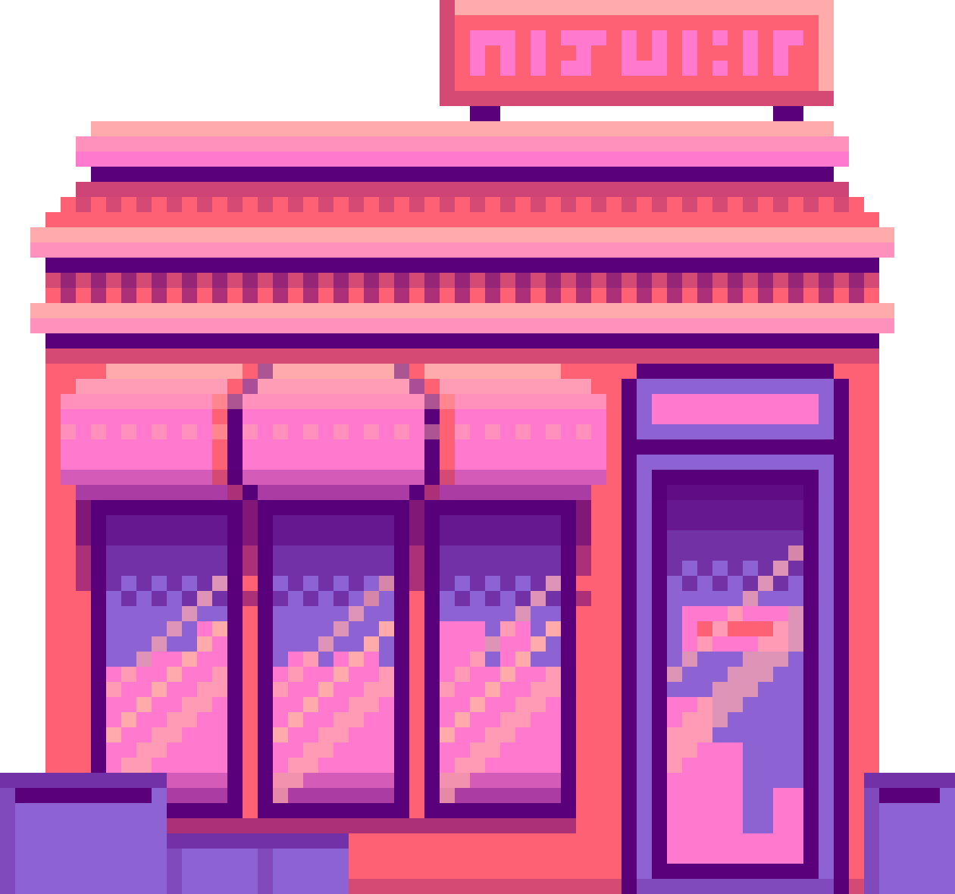



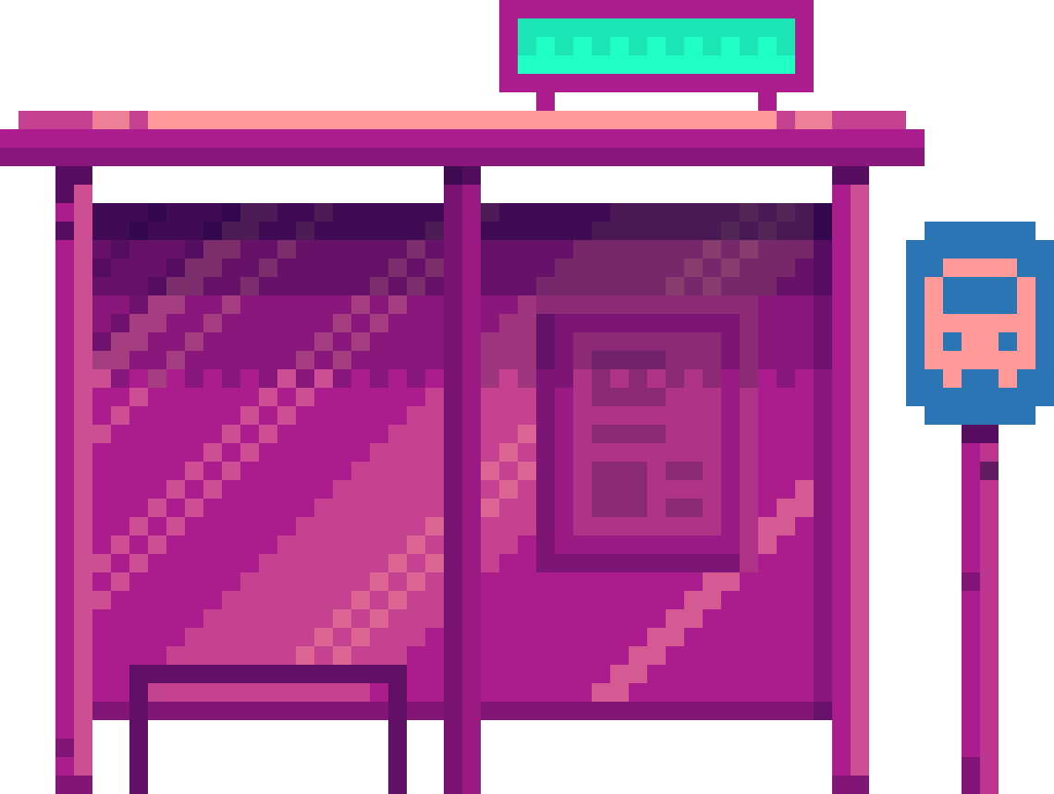






BLAST FROM THE PAST:
ALLIA’S
QUEST
REBOOTED
TEAM LETTER S

Slide 2

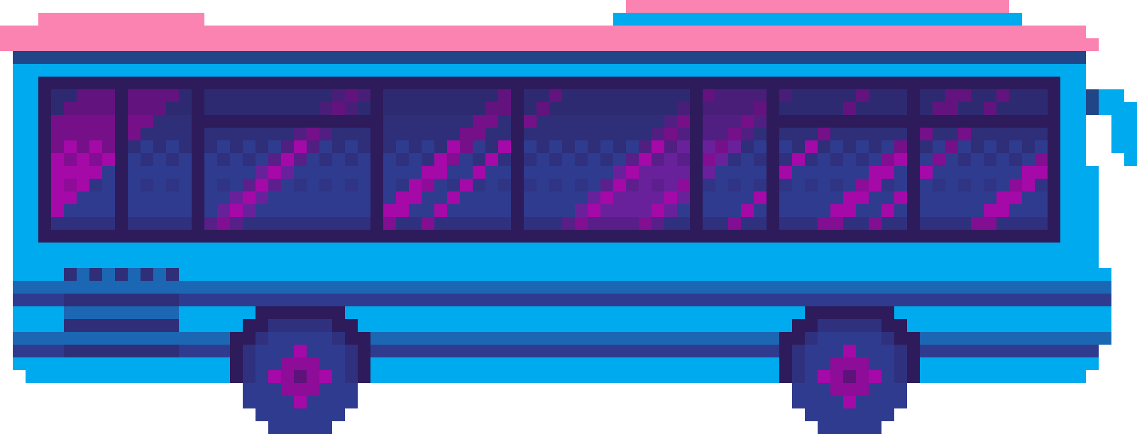
WHAT IS ALLIA’S QUEST
ALLIA QUEST: REBOOTED IS A MODERN TWIST ON A CLASSIC ALIEN SHOOTER. STEP INTO THE SHOES OF ALLIA, AN INTERSTELLAR PILOT DEFENDING HUMANITY FROM A RELENTLESS ALIEN INVASION. WITH FAST-PACED MOVEMENT, VERTICAL/HORIZONTAL DODGING, AND LASER-PRECISE BULLET MECHANICS, THIS GAME REVIVES THE NOSTALGIC ARCADE VIBE WITH FRESH, RESPONSIVE GAMEPLAY.

Slide 3
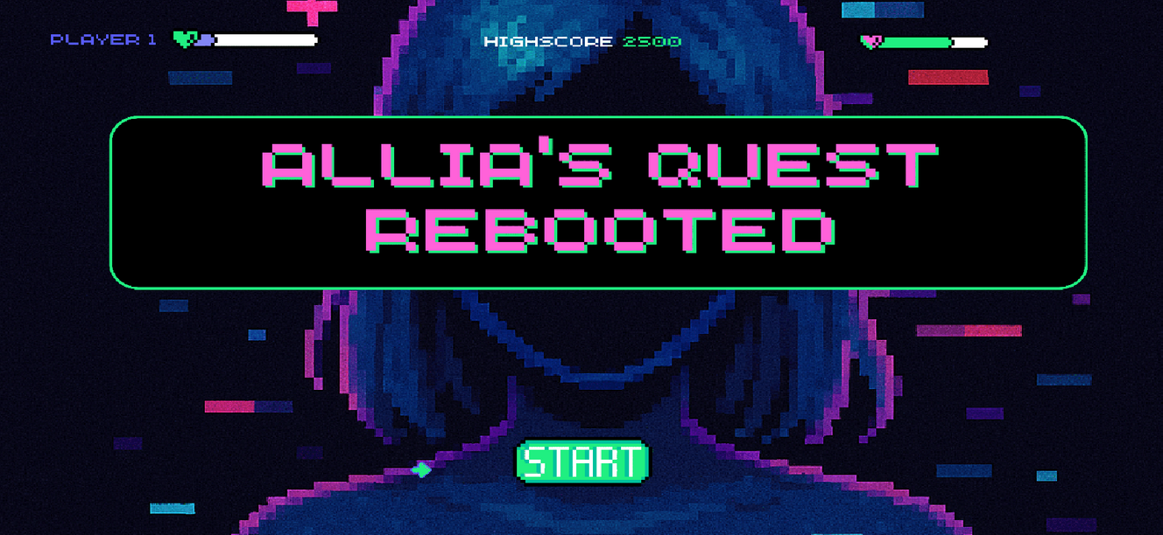
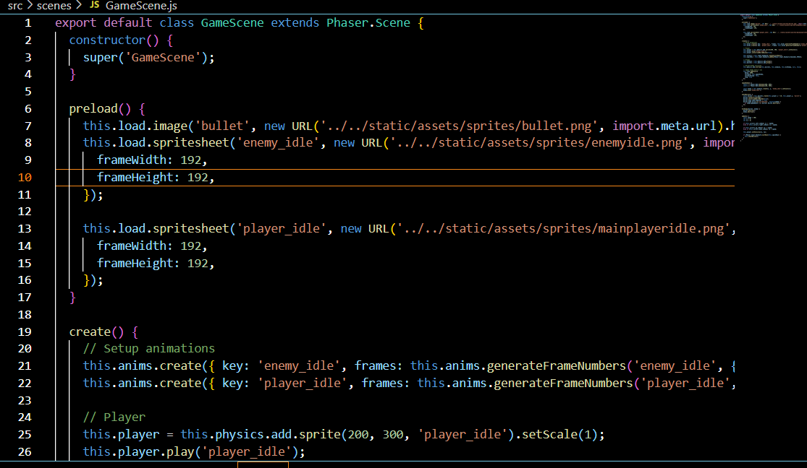

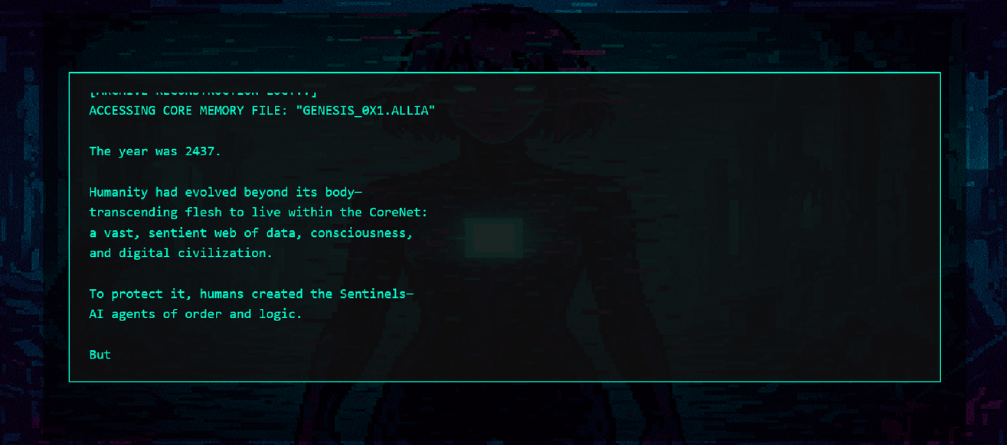
SCREENSHOTS FROM THE GAME

Slide 4




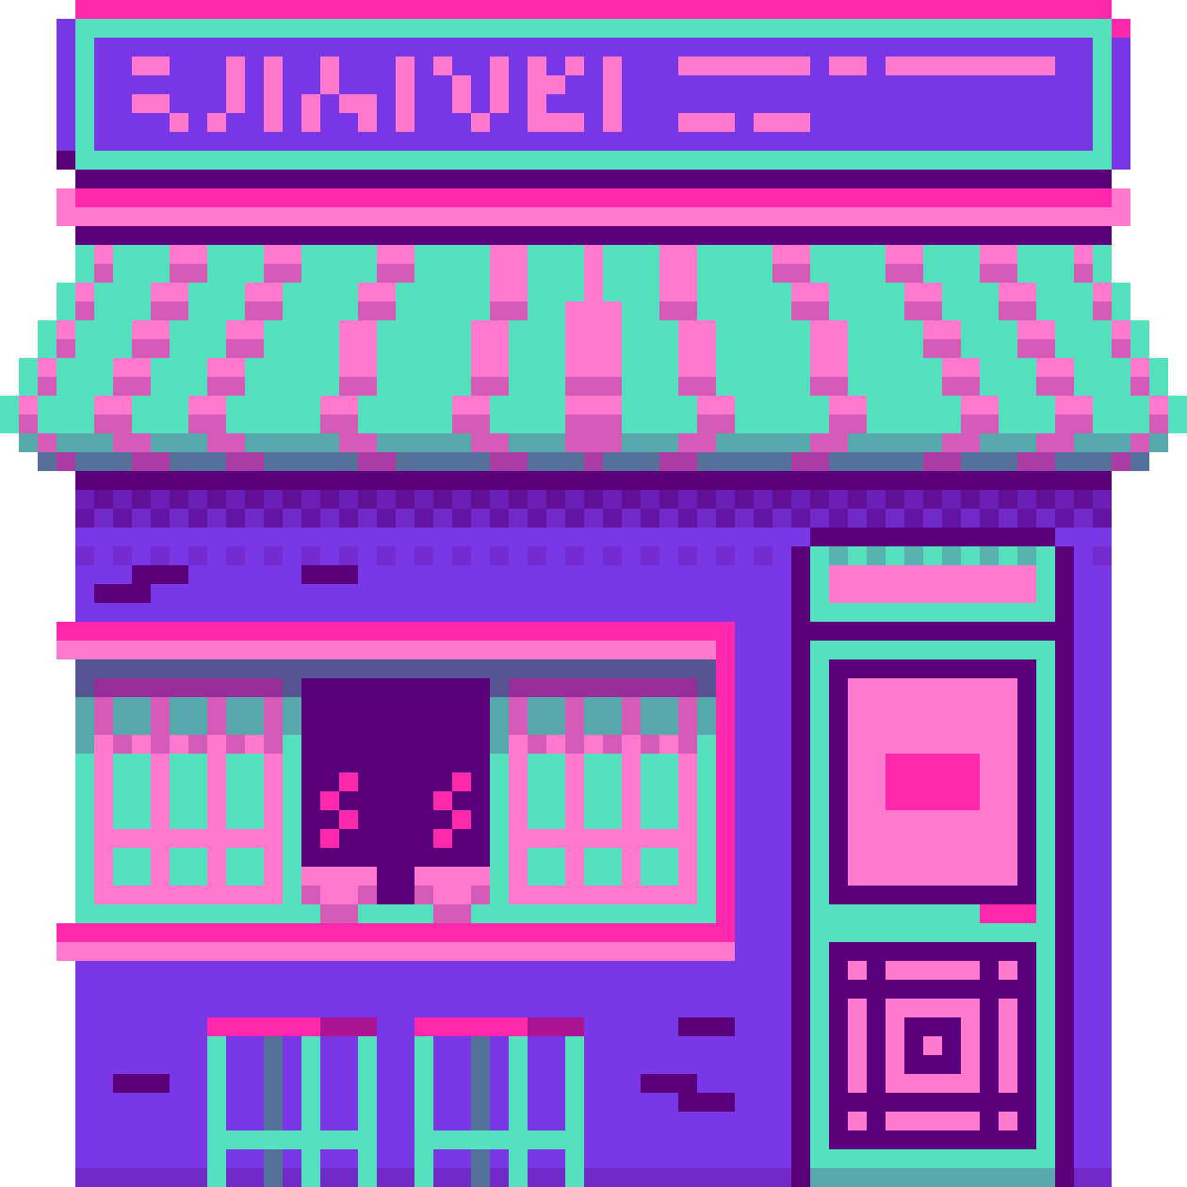



WHO IS THIS
FOR?
OUR CUSTOMER IS A MODERN GAMER OR TECH ENTHUSIAST WHO CRAVES NOSTALGIC EXPERIENCES WITH A MODERN TWIST. THIS INCLUDES GEN Z USERS DISCOVERING RETRO TECH FOR THE FIRST TIME, AND MILLENNIALS WHO GREW UP ON FLOPPY DISKS, DIAL-UP TONES, AND EARLY PC GAMES.

Slide 5
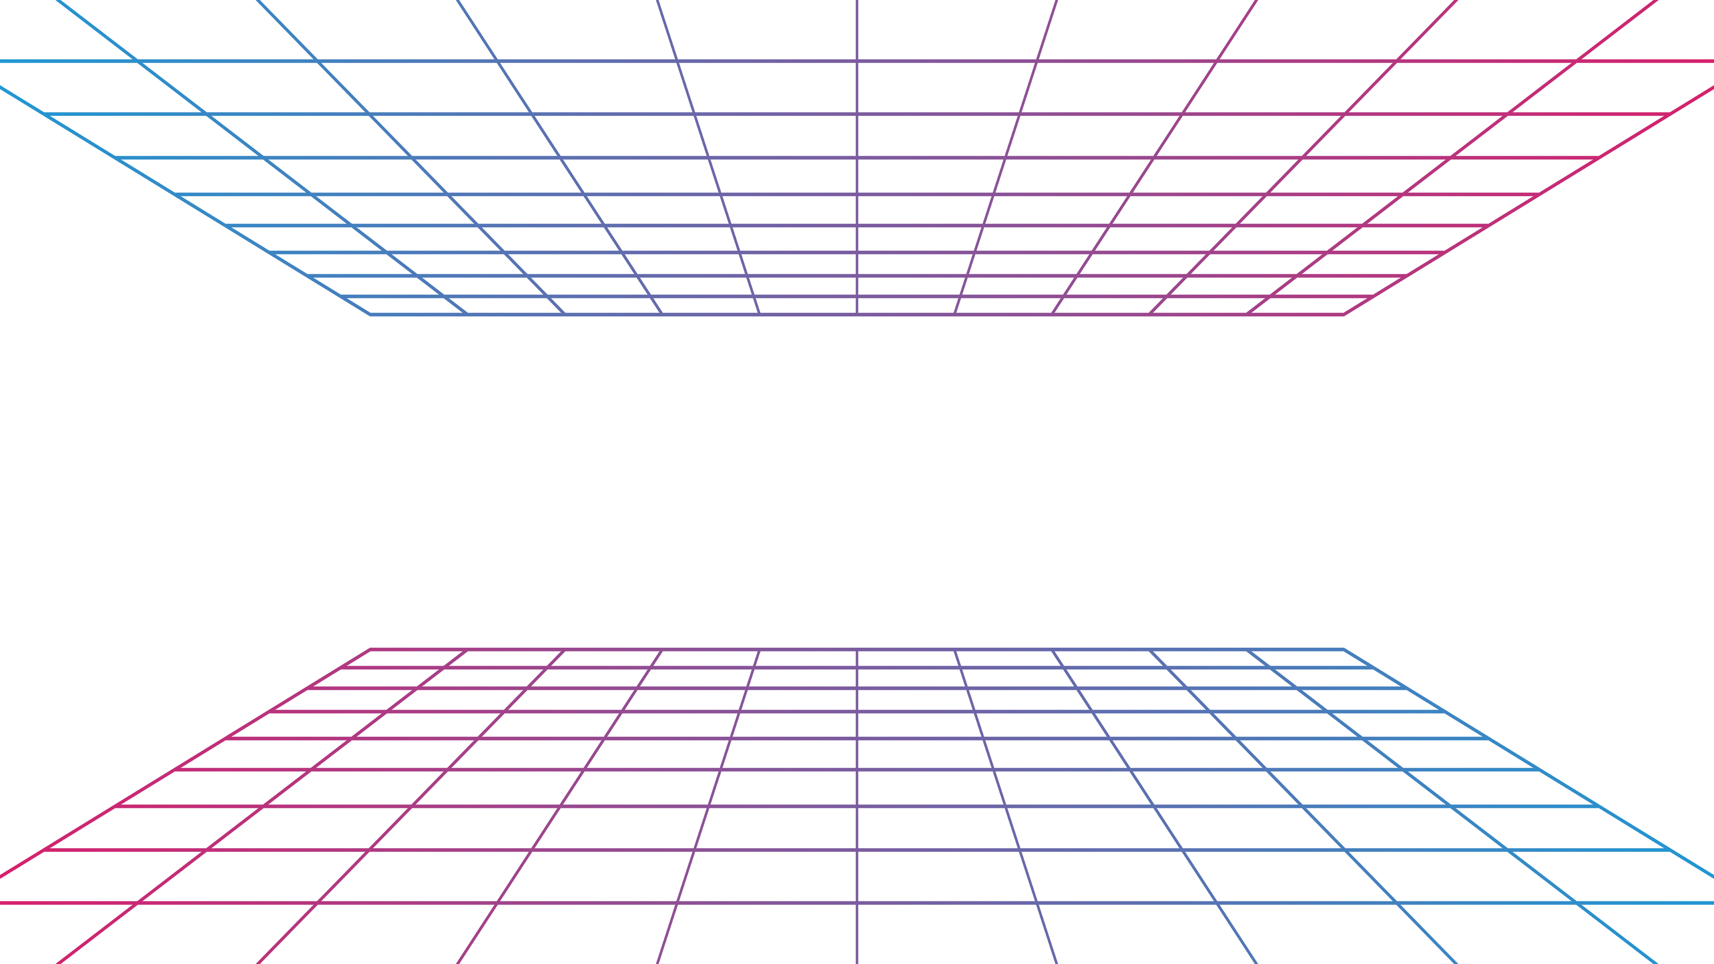

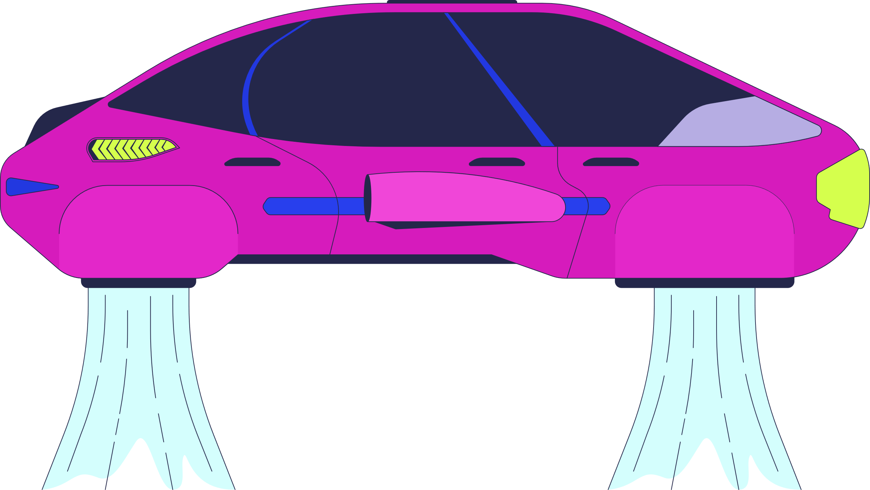

HOW AND WHY DID WE SELECT THIS IDEA
There's a cultural resurgence in retro aesthetics like Y2K fashion, vaporwave, and CRT filters.
However, there's a lack of interactive games that combine retro hardware (e.g., Atari joystick) with modern web tech.
Research shows growing interest in low-latency browser games and gamepad support.
We chose this problem because it bridges generations: nostalgic for older users, novel for younger ones.
It celebrates creative reuse by repurposing old tech (e.g., Atari joysticks) in modern browser games using the Gamepad API.

Slide 6

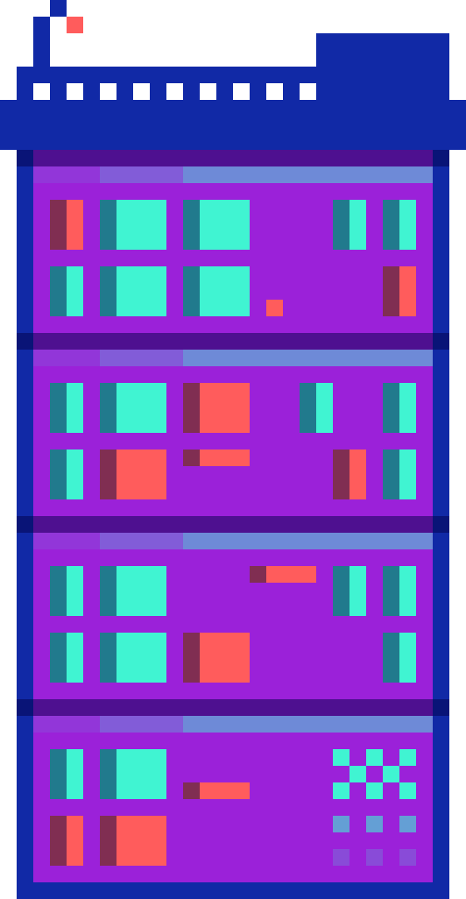

HOW IS IT DIFFERENT FROM EXISTING IDEAS?
Most retro games either stay locked in emulators or try to completely modernize the experience. Our redesign embraces the past visually and physically, while layering in:
Modern web tech (HTML5, Gamepad API)
Dynamic CRT-glitch visuals
A responsive and deployable web game

Slide 7

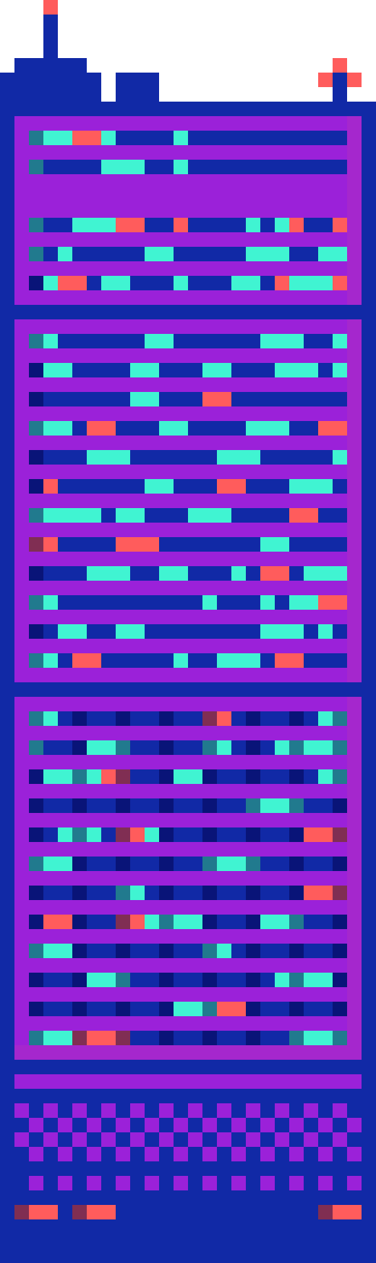
HOW DOES IT MEET THE AUDIENCE’S NEEDS
We deliver a playable, joyful, interactive experience that is:
Easy to access (runs in browser)
Nostalgic yet modern (retro look + smooth feel)
Compatible with modern Bluetooth/USB gamepads
Fun for all levels of gamers — casual and hardcore

